Slide 1
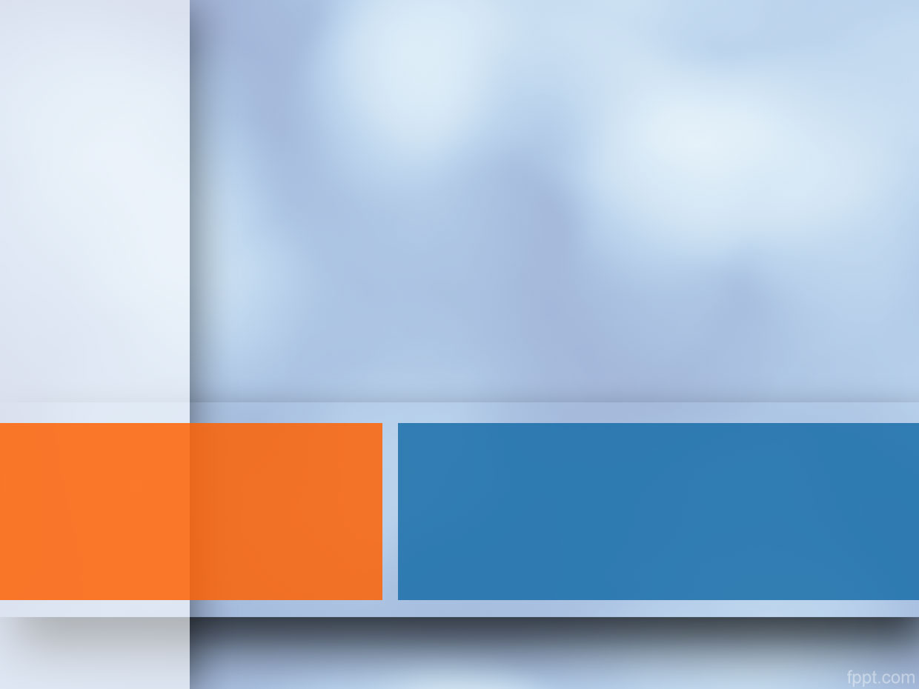
Enhanced ER Modeling
Chapter # 04

Slide 2
Enhanced ER (EER) model
Created to design more accurate database schemas
Reflect the data properties and constraints more precisely
More complex requirements than traditional applications

Slide 3
Enhanced ER (EER) model
EER model includes all modeling concepts of the ER model
In addition, EER includes:
Subclasses and super classes
Specialization and generalization
Category or union type
Attribute and relationship inheritance

Slide 4
Subclasses and Super classes
In many cases an entity type has numerous sub groupings of its entities that are meaningful and need to be represented explicitly because of their significance to the database application.
For example: EMPLOYEE may be further grouped into:
SECRETARY, ENGINEER, TECHNICIAN, …
Based on the EMPLOYEE’s Job
MANAGER
EMPLOYEEs who are managers
SALARIED_EMPLOYEE, HOURLY_EMPLOYEE
Based on the EMPLOYEE’s method of pay

Slide 5
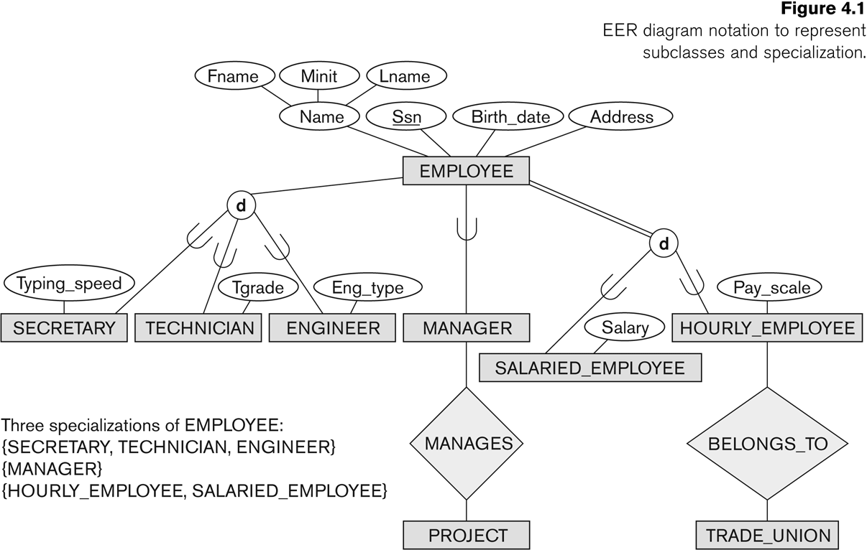

Slide 6
Subclasses and Super classes
We call each of these sub groupings a subclass of the EMPLOYEE entity type, and the EMPLOYEE entity type is called the super class for each of these subclasses.
These are called super class/subclass (as well as simply class/subclass) relationships:
EMPLOYEE/SECRETARY
EMPLOYEE/TECHNICIAN
EMPLOYEE/MANAGER
These are also called IS-A relationships
SECRETARY IS-A EMPLOYEE, TECHNICIAN IS-A EMPLOYEE, ….

Slide 7
Subclasses and Super classes
An Entity CANNOT exist in the database only by being a member of a subclass; it must also be a member of the superclass
A member of the superclass can be optionally included as a member of any number of its subclasses

Slide 8
Subclasses and Super classes
A salaried employee who is also an engineer belongs to the two subclasses:
ENGINEER, and SALARIED_EMPLOYEE
A salaried employee who is also an engineering manager belongs to the three subclasses:
MANAGER,ENGINEER, and SALARIED_EMPLOYEE
It is not necessary that every entity in a superclass be a member of some subclass

Slide 10
Subclasses, Superclasses and Inheritance
An important concept associated with subclasses is that of Type inheritance
An entity that is member of a subclass inherits
All attributes of the entity as a member of the superclass
All relationships of the entity as a member of the superclass

Slide 12
Subclasses, Superclasses and Inheritance
In the previous slide, SECRETARY (as well as TECHNICIAN and ENGINEER) inherit the attributes Name, SSN, …, from EMPLOYEE
Every SECRETARY entity will have values for the inherited attributes
Every SECRETARY entity will also keep all relationships

Slide 13
Specialization
Specialization is the process of defining a set of subclasses of an entity type
The set of subclasses is based upon some distinguishing characteristics of the entities in the super class
Example:
{SECRETARY, ENGINEER, TECHNICIAN} is a specialization of EMPLOYEE based upon job type.

Slide 14
Specialization
There may be several specializations of the same super class
Example: Another specialization of EMPLOYEE based on method of pay
is {SALARIED_EMPLOYEE, HOURLY_EMPLOYEE}.
The subset symbol on each line connecting a subclass to the circle indicates the direction of the super class/subclass relationship.

Slide 15
Specialization
Attributes of a subclass are called specific or local attributes.
For example, the attribute Typing Speed of SECRETARY
The subclass can also participate in specific relationship types
For example, a relationship BELONGS_TO HOURLY_EMPLOYEE

Slide 17
Specialization
In summary, the specialization process allows us to do the following
Define a set of subclass of an entity type
Establish additional specific attributes with each subclass
Establish additional specific relationship types between each subclass and other entity types or other subclasses

Slide 18
Generalization
The reverse of the specialization process
Several classes with common features are generalized into a superclass; original classes become its subclasses
Example: CAR, TRUCK generalized into VEHICLE; both CAR, TRUCK become subclasses of the superclass VEHICLE.
We can view {CAR, TRUCK} as a specialization of VEHICLE
Alternatively, we can view VEHICLE as a generalization of CAR and TRUCK

Slide 19
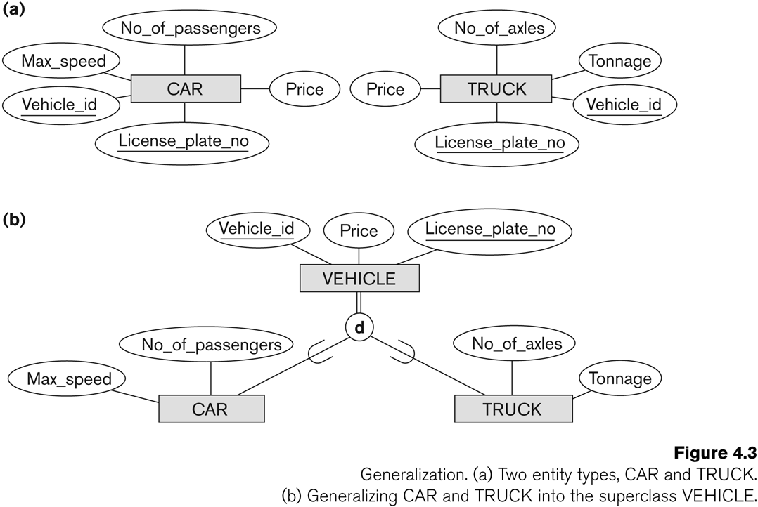
Generalization

Slide 20
Generalization
Diagrammatic notation sometimes used to distinguish between generalization and specialization
Arrow pointing to the generalized super class represents a generalization
Arrows pointing to the specialized subclasses represent a specialization
We do not use this notation because it is often subjective as to which process is more appropriate for a particular situation

Slide 21
Generalization
Data Modeling with Specialization and Generalization
A superclass or subclass represents a set of entities
Shown in rectangles in EER diagrams (as are entity types)
Sometimes, all entity sets are simply called classes, whether they are entity types, superclasses, or subclasses

Slide 22
Constraints on Specialization and Generalization
If we can determine exactly those entities that will become members of each subclass by a condition, the subclasses are called predicate-defined (or condition-defined) subclasses
Condition is a constraint that determines subclass members
Display a predicate-defined subclass by writing the predicate condition next to the line attaching the subclass to its superclass
If all subclasses in a specialization have membership condition on same attribute of the superclass, specialization is called an attribute defined-specialization
Attribute is called the defining attribute of the specialization
Example: JobType is the defining attribute of the specialization {SECRETARY, TECHNICIAN, ENGINEER} of EMPLOYEE

Slide 23
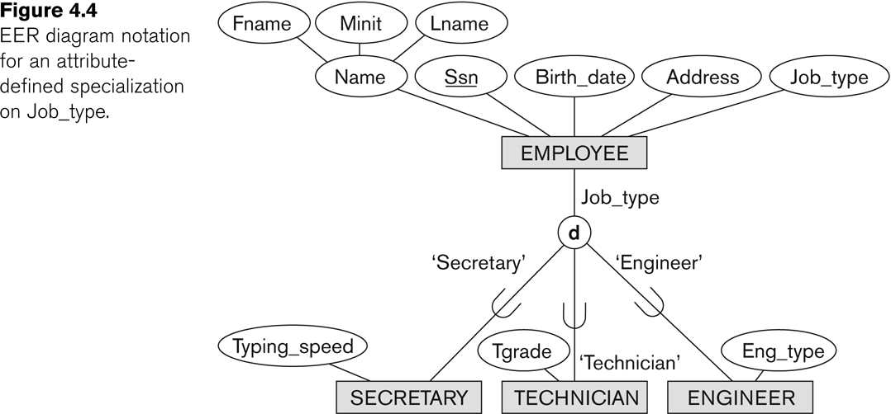
Constraints on Specialization and Generalization

Slide 24
Constraints on Specialization and Generalization
If no condition determines membership, the subclass is called user-defined
Membership in a subclass is determined by the database users by applying an operation to add an entity to the subclass
Membership in the subclass is specified individually for each entity in the superclass by the user

Slide 25
Constraints on Specialization and Generalization
Two basic constraints can apply to a specialization/generalization
Disjointness Constraint
Completeness Constraint

Slide 26
Disjointness Constraint
Specifies that the subclasses of the specialization must be disjointed
(an entity can be a member of at most one of the subclasses of the specialization)
Specified by d in EER diagram
If not disjointed, overlap; that is the same entity may be a member of more than one subclass of the specialization
Specified by o in EER diagram

Slide 27
Disjointness Constraint

Slide 28
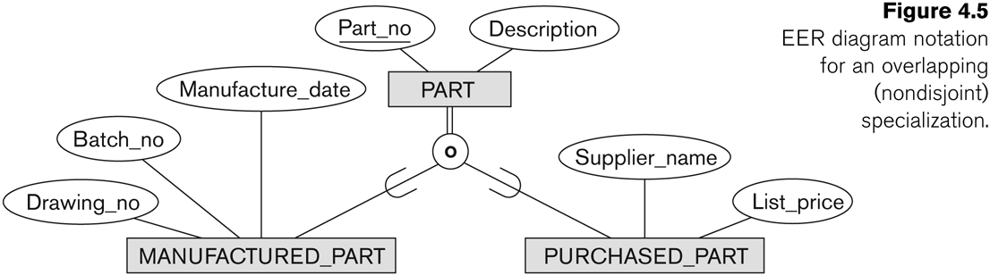
Overlapping Constraint

Slide 29
Completeness Constraint
Completeness Constraint
Total specifies that every entity in the super class must be a member of some subclass in the specialization/ generalization
Shown in EER diagrams by a double line
For example, if every EMPLOYEE must be either an HOURLY_EMPLOYEE or a SALARIED_EMPLOYEE, then the specialization
{HOURLY_EMPLOYEE,SALARIED_EMPLOYEE} in is a total specialization of EMPLOYEE
Partial allows an entity not to belong to any of the subclasses
Shown in EER diagrams by a single line
For example, if some EMPLOYEE entities do not belong to any of the subclasses {SECRETARY,ENGINEER,TECHNICIAN} in, then that specialization is partial

Slide 30
Completeness Constraint
The disjointness and completeness constraints are independent.
Hence, we have the following four possible constraints on specialization:
Disjoint, total
Disjoint, partial
Overlapping, total
Overlapping, partial

Slide 31
Constraints on Specialization and Generalization
Some general rules
Deleting an entity from s superclass implies that it is automatically deleted from all the subclasses to which it belongs
Inserting an entity in a superclass of a total specialization implies that the entity is mandatorily inserted in at least one of the subclasses of the specialization

Slide 32
Specialization / Generalization Hierarchies, Lattices and Shared Subclasses
A subclass may itself have further subclasses specified on it
Forms a hierarchy or a lattice
Hierarchy has a constraint that every subclass has only one superclass (called single inheritance)
In a lattice, a subclass can be subclass of more than one superclass (called multiple inheritance)
In a lattice or hierarchy, a subclass inherits attributes not only of its direct superclass, but also of all its predecessor superclasses
A subclass with more than one superclass is called a shared subclass

Slide 33
Specialization / Generalization Hierarchies, Lattices and Shared Subclasses
In specialization, start with an entity type and then define subclasses of the entity type by successive specialization (top down conceptual refinement process)
In generalization, start with many entity types and generalize those that have common properties (bottom up conceptual synthesis process)

Slide 34
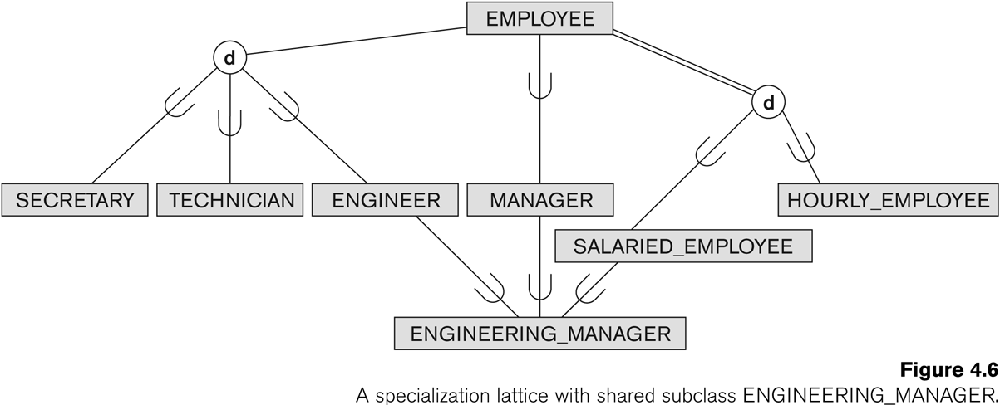
Specialization Lattice

Slide 35
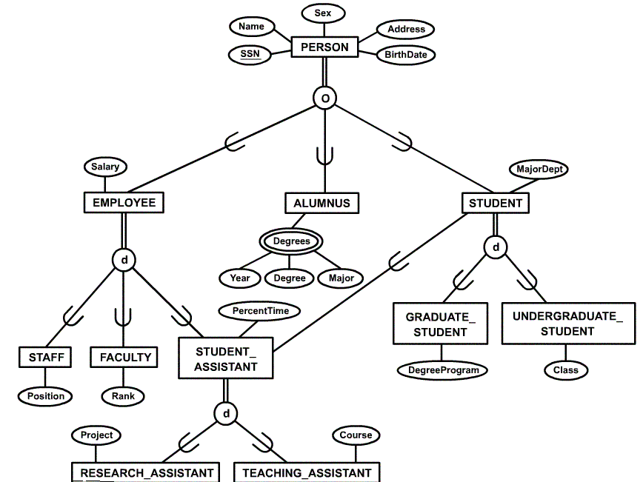

Slide 36
Categories (UNION TYPES)
All of the superclass/subclass relationships we have seen thus far have a single superclass
A shared subclass is subclass in more than one distinct superclass/subclass relationships, where each relationships has a single superclass (multiple inheritance)
In some cases, need to model a single superclass/subclass relationship with more than one superclass
Superclasses represent different entity types
Such a subclass is called a category or UNION TYPE

Slide 37
Categories (UNION TYPES)
Example: Database for vehicle registration, vehicle owner can be a person, a bank (holding a lien on a vehicle) or a company.
Category (subclass) OWNER is a subset of the union of the three superclasses COMPANY, BANK, and PERSON
A category member must exist in at least one of its superclasses
Note: The difference from shared subclass, which is subset of the intersection of its superclasses (shared subclass member must exist in all of its superclasses).

Slide 38
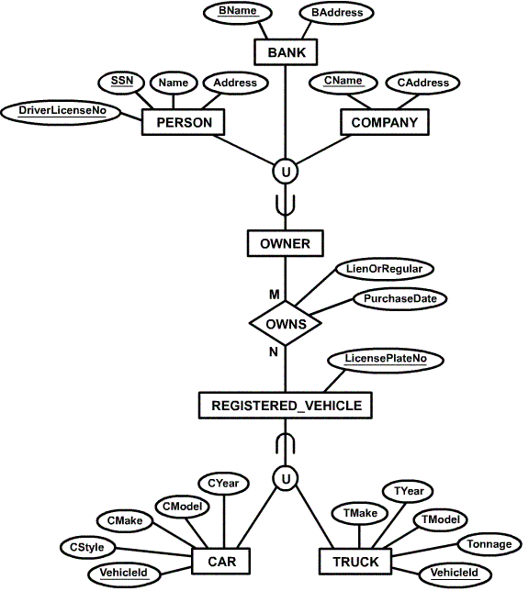

Slide 39
Categories (UNION TYPES)
We can compare a UNION (OWNER) with shared subclass (ENGINEERING_MANAGER)
The latter is a subclass of each of the three superclass ENGINEER, MANAGER and SALARIED_EMPLOYEE, so an entity that us a member of ENGINEERING_MANAGER must exist in all three
This means that an engineering manager must be an ENGINEER, a MANAGER, and a SALARIED_EMPLOYEE
On the other hand, an entity that is a member of OWNER must exist in only one of the superclass

Slide 40
Categories (UNION TYPES)
Attribute inheritance works more selectively in the case of UNION.
For example, OWNER entity inherits attributes of a COMPANY, a PERSON OR a BANK
A shared subclass such as ENGINEERING_MANAGER inherits ALL the attributes of its superclasses

